Slide 1
No Silver Bullet: Optimized Montgomery Multiplication on Various 64-bit ARM Platforms
Hwajeong Seo¹, Pakize Sanal², Wai-Kong Lee³, Reza Azarderakhsh²
¹Hansung University, ²Florida Atlantic University, ³Gachon University
21. 08. 13.

Slide 2
Introduction
Related Work
Proposed Method & Evaluation
Conclusion

Slide 3
Motivation
High-speed implementation of cryptography is important to achieve high availability.
In order to improve the performance, the core operation of cryptography should be implemented efficiently.
e.g. public key cryptography → multiplication
Previous works devoted to improve the performance only on specific platforms.
In this paper, we point out that the performance of implementation is varied depending on platforms w/ same base architecture (e.g. ARM). → We should carefully select the proper algorithm on specific platform!

Slide 4
Contribution
Optimized Montgomery multiplication on ARM64 architecture
w/ Karatsuba algorithm and instruction sets of ARM64
Efficient implementation of CSIDH on ARM64 architecture
Full protocols of CSIDH-P511 on 64-bit ARM Cortex-A and Apple A
In-depth performance evaluation on ARM64 architecture
Analysis of Montgomery multiplication and CSIDH on both architectures
Karatsuba is not the best solution across all ARM64 architectures

Slide 5

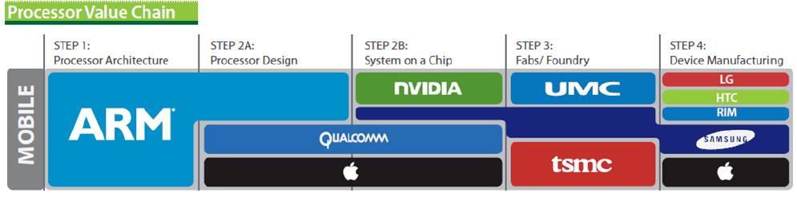
Target Platform – ARM64
Almost all smartphones based on ARM architecture
Modern smartphone supports 64-bit ARMv8

Slide 6
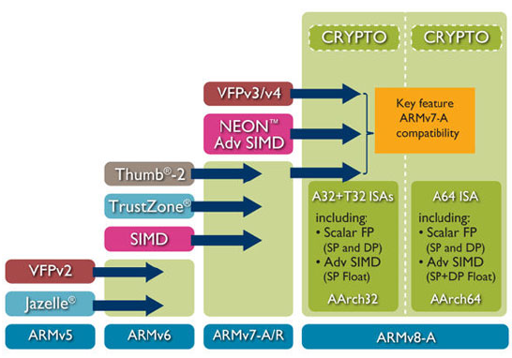
Target Platform – ARM64
32-bit mode (AArch32) & 64-bit mode (AArch64)
64-bit ARM & 128-bit NEON registers and instruction sets
Crypto (AES and SHA) operation

Slide 7


Multiplication on ARM64
X0
a0
X0
a0
$$×$$
$$×$$
X1
b0
X1
b0
a1b0
a0b0
a0b0
a0b0
X3
X2
64 bits
X3
64 bits
X2
MUL
UMULH

Slide 8
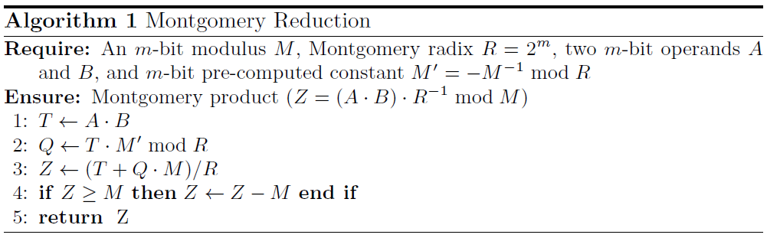

Montgomery Multiplication
Replacing expensive divition into multiplication.
Division $≈$ 100~1000 multiplication

Slide 9
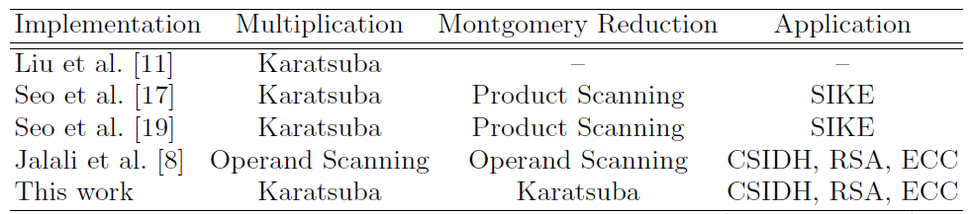
Comparison of Montgomery Multiplication on ARM64
This is the first Montgomery reduction implementation with Karatsuba algorithm.
Application is CSIDH, RSA, and ECC.

Slide 10
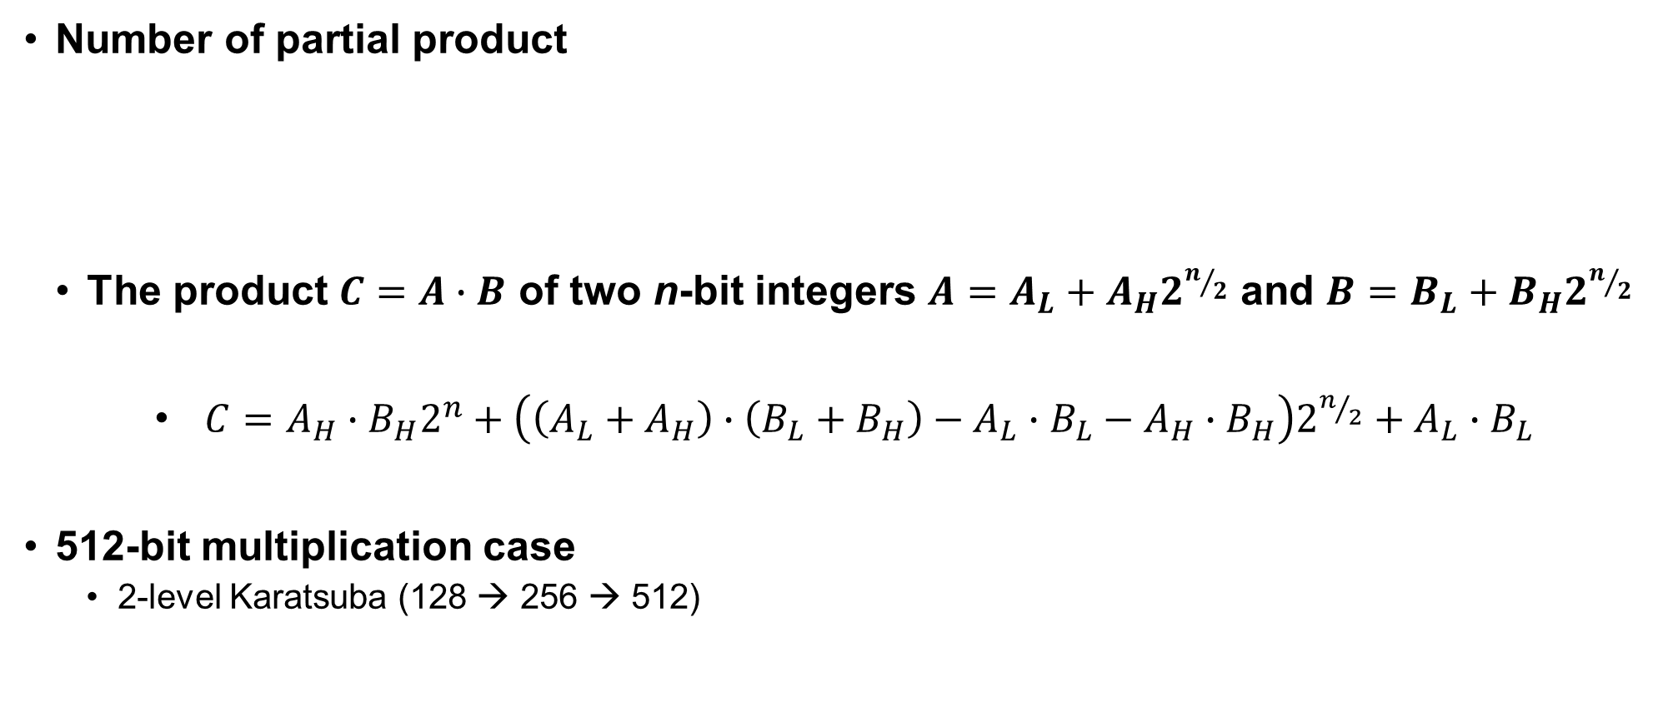
Karatsuba-Ofman Algorithm
Number of partial product
The product $C=A∙B$ of two n-bit integers $A=A_{L}+A_{H}2^{n/2}$ and $B=B_{L}+B_{H}2^{n/2}$
$C=A_{H}∙B_{H}2^{n}+\left(\left(A_{L}+A_{H}\right)∙\left(B_{L}+B_{H}\right)−A_{L}∙B_{L}−A_{H}∙B_{H}\right)2^{n/2}+A_{L}∙B_{L}$
512-bit multiplication case
2-level Karatsuba (128 → 256 → 512)
School-book | Karatsuba-Ofman
$$N^{2}$$ | $$N^{\log_{2}{3}}$$

Slide 11
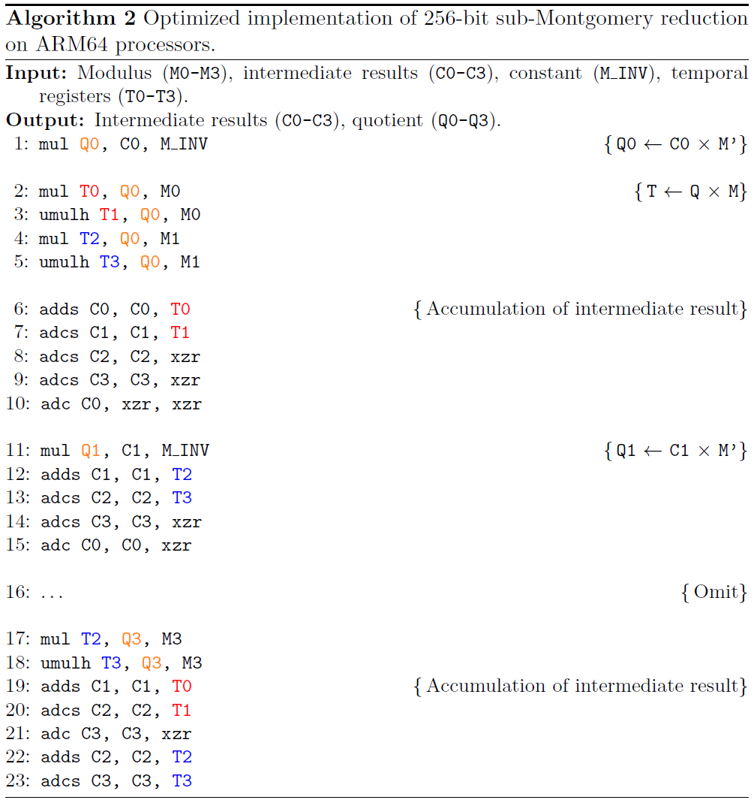

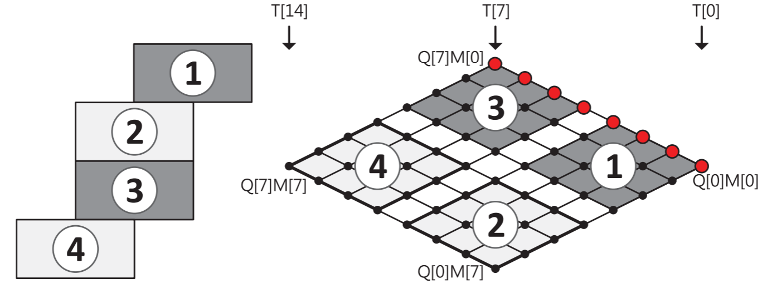
Karatsuba + Montgomery Multiplication ( 1 / 2 )
Register utilization
Read-write dependency avoidance
Steps 1 and 3 are performed in Algorithm 2.
Steps 2 and 4 are performed with Karatsuba.

Slide 12
Karatsuba + Montgomery Multiplication ( 2 / 2 )
512-bit Montgomery multiplication
2-level Karatsuba multiplication → hybrid reduction (1-level Karatsuba)
Acceleration of public key cryptography
CSIDH-P511 based on the proposed 512-bit Montgomery multiplication
Conventional public key based on random prime (RSA and ECC) can be accelerated with the proposed method.

Slide 13
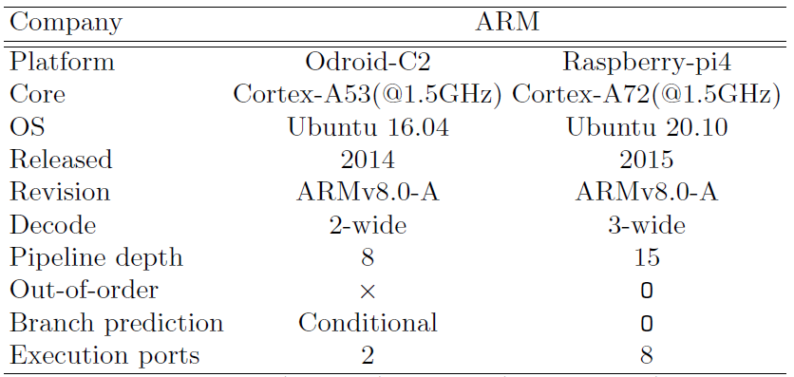
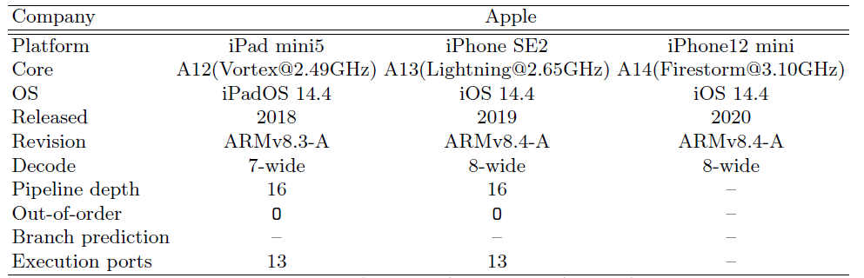

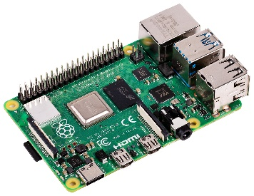


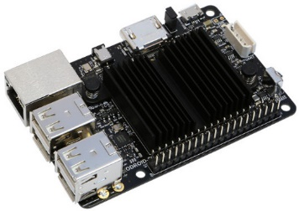
Evaluation (Target Platforms)
ARM processors are largely divided into Cortex-A and Apple A.
Previous works mainly evaluated on Cortex-A processors rather than Apple A.
In this work, we evaluated same codes on both platforms.

Slide 14
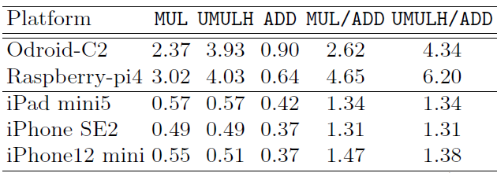
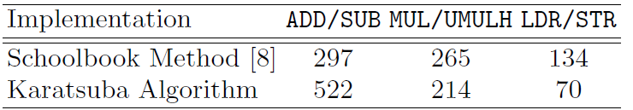
Evaluation ( 1 / 2 )
Cortex-A series show higher MUL/ADD ratio than Apple A processor.
Karatsuba algorithm requires many addition operations than schoolbook.

Slide 15
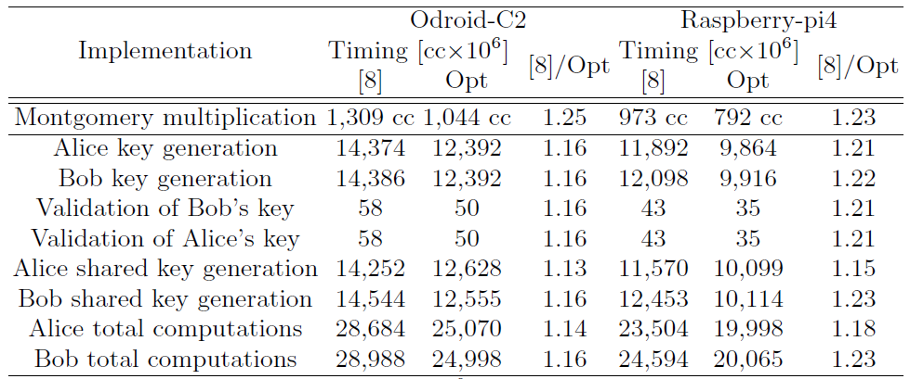
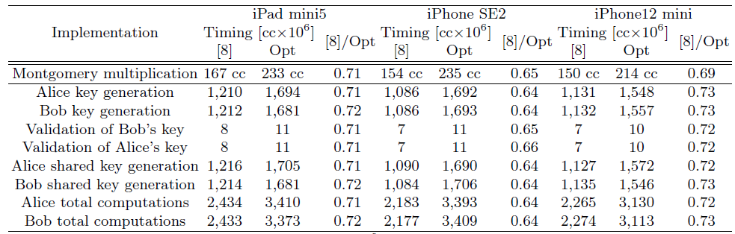
Evaluation ( 2 / 2 )
[8] is schoolbook method and optimized version is Karatsuba.
On Cortex-A, Karatsuba approach shows better than schoolbook.
However, schoolbook is better than Karatsuba on Apple A.

Slide 16
Conclusion
Achievements
Optimized Montgomery multiplication w/ Karatsuba and specific instructions.
However, Apple A processors w/ low multiplication latency achieved the better performance with the schoolbook method.
The implementation should be evaluated on various ARM platforms for fair comparison and practicality.
Future works
Improving the Microsoft-SIDH library on Apple A processors by utiizing the schoolbook.
Investigating the multiplication method for various integer lengths.
Public domain (https://bit.ly/3rOLv4H)!

